Slide 2
Phylum Chordata
Subphylum Vertebrata
Vertebrates
These organisms have a dorsal nerve cord and vertebrae.
Bilateral Symmetry
Notes:
!

Slide 3
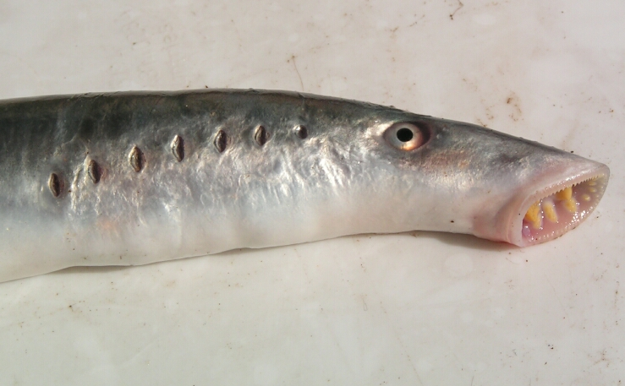
Agnatha
Lamprey and Hagfish
Vertebrate Made of Cartilage
Lack Scales
Ectothermic
External Fertilization
Have Slimy Skin
A.K.A. Jawless Fish
Notes:
T

Slide 4
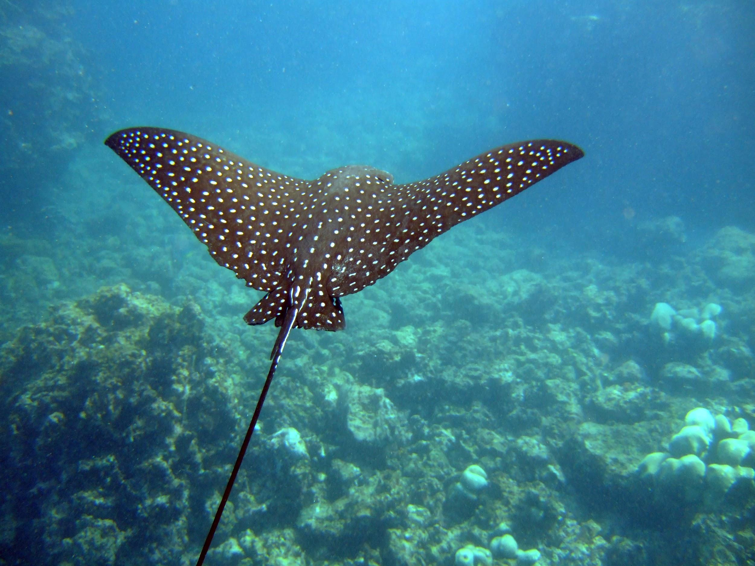
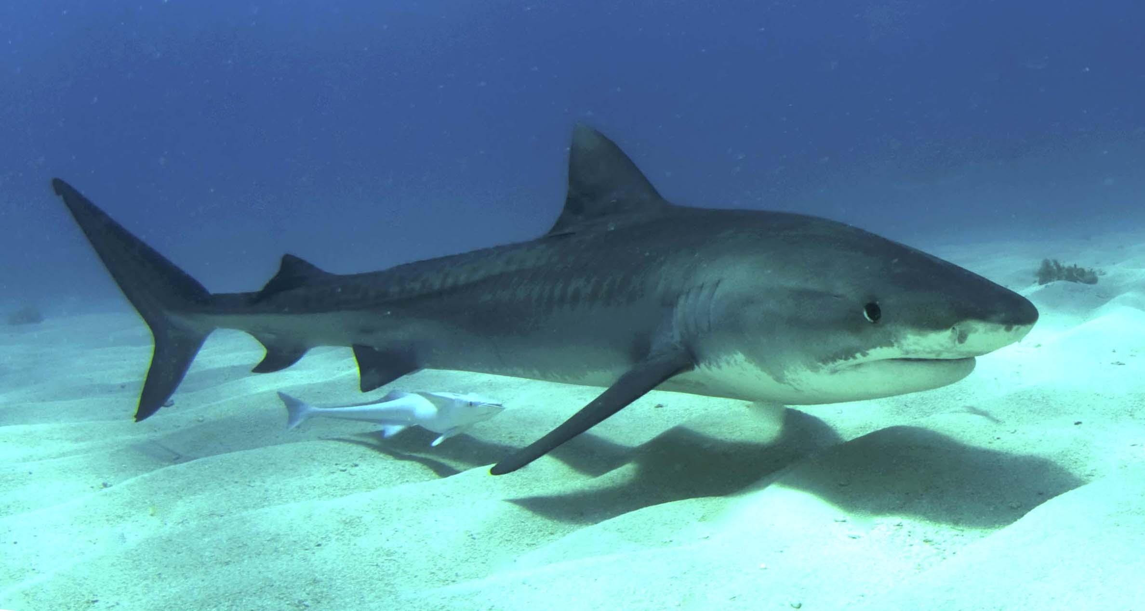
Chondrichthyes
Cartilagenous Fish (Bone is actually cartilage)
Sharks, Skates, and Rays
Scales
Ectothermic
2 Pairs of Fins
Internal Fertilization
Notes:
D

Slide 5
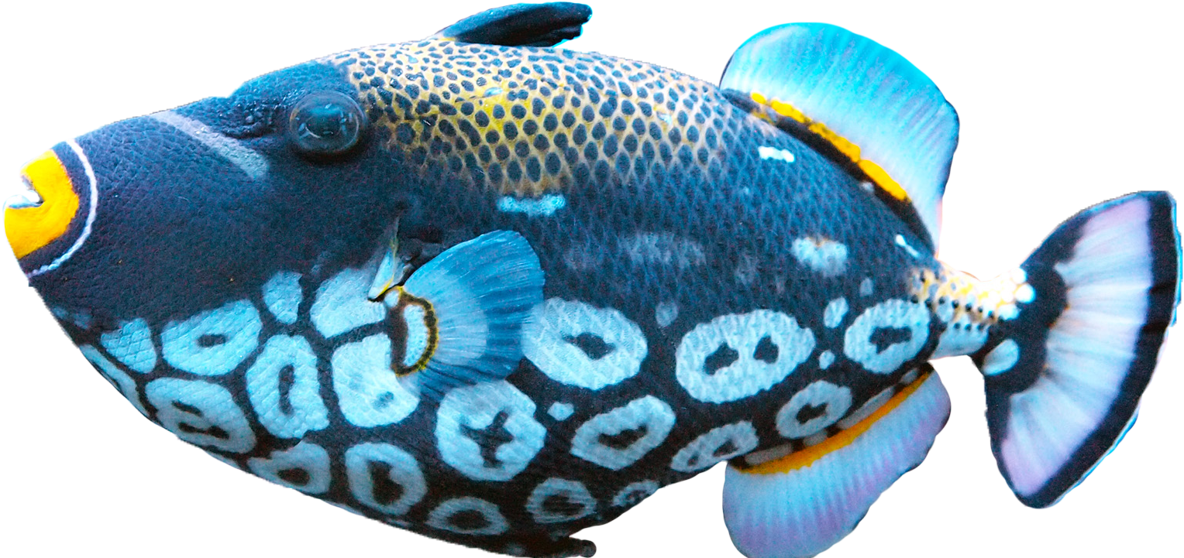
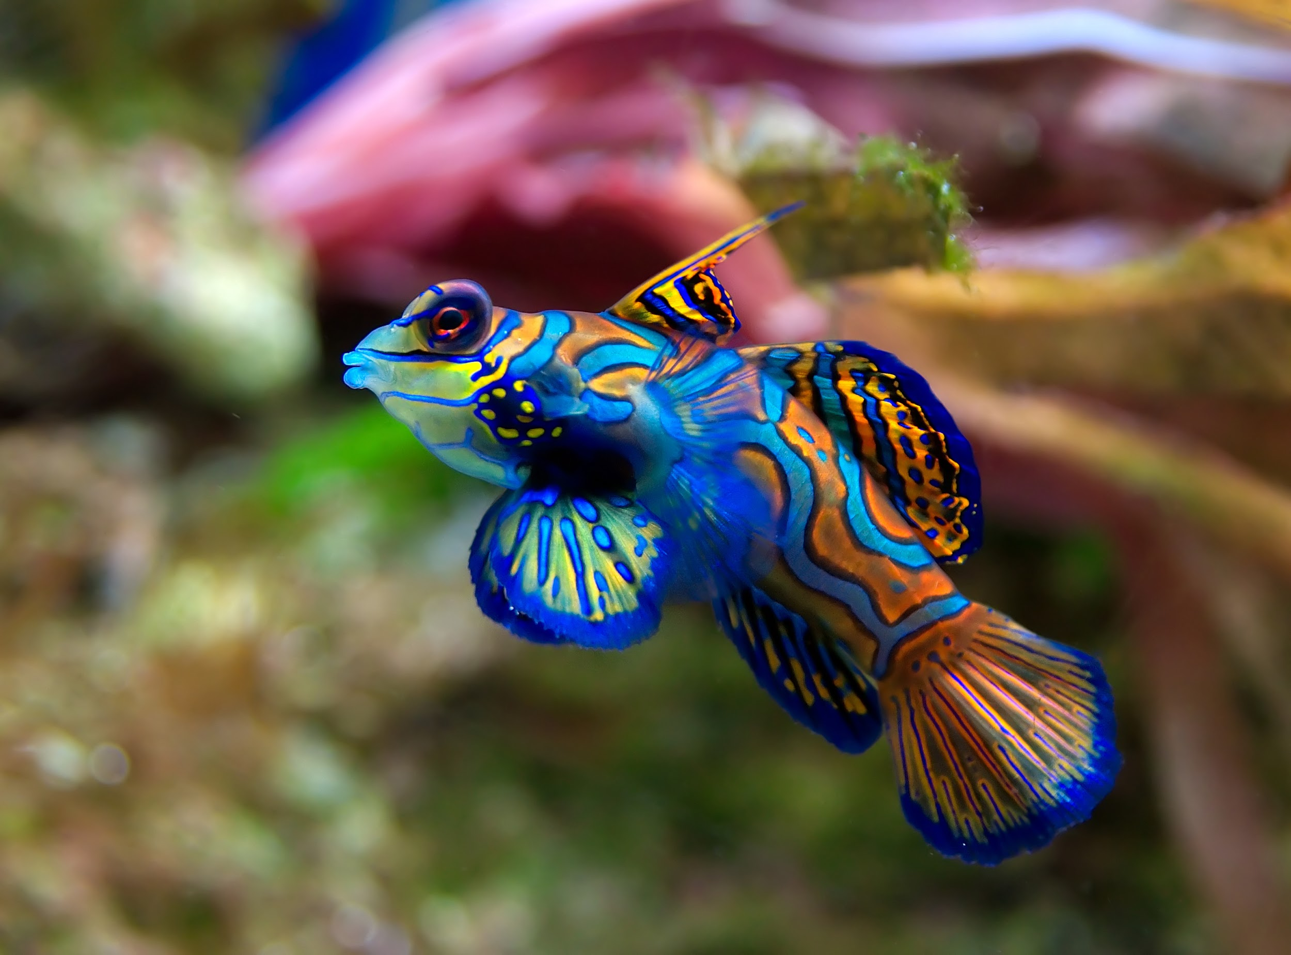
Osteichthyes
“Bony Fish” True Bone for a skeleton
Ectotherm
2 pairs of fins and Gills
External fertilization
Have a swim bladder to keep them buoyant
Trout, Bass, Flounder
Notes:
N

Slide 6
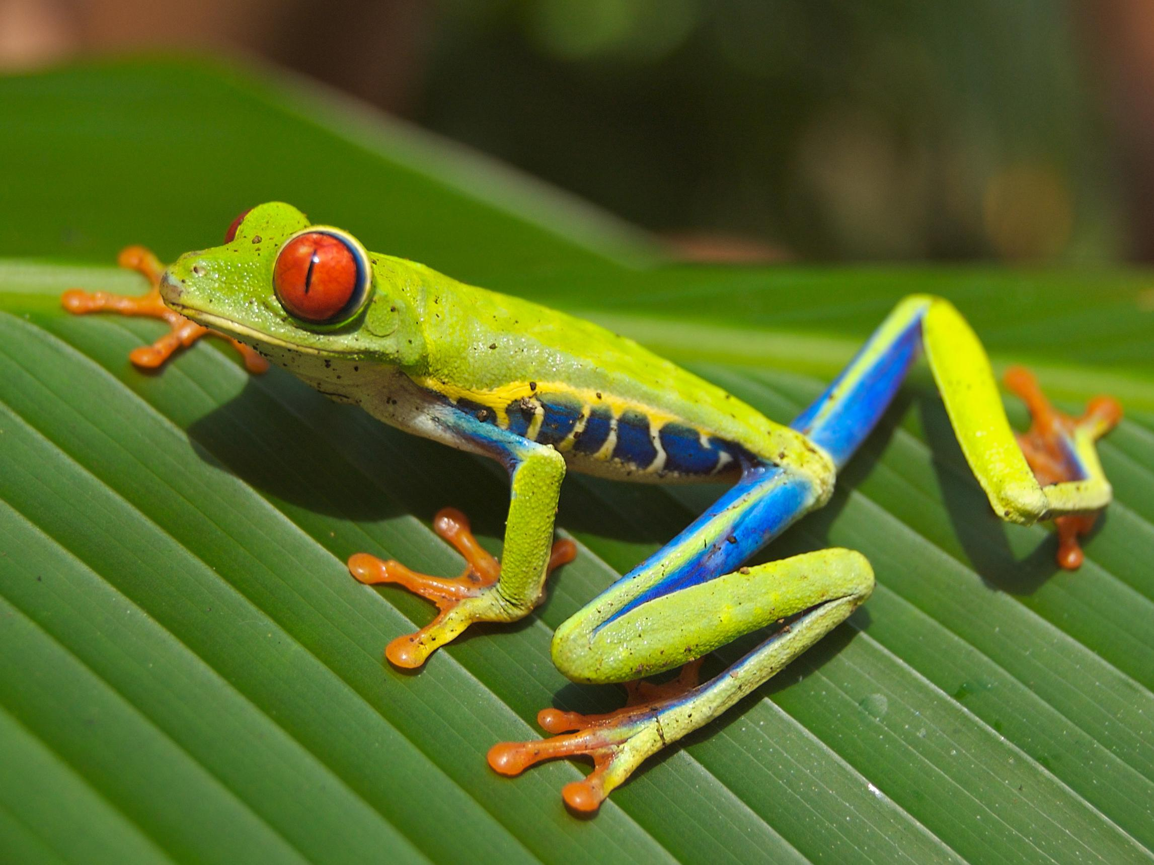
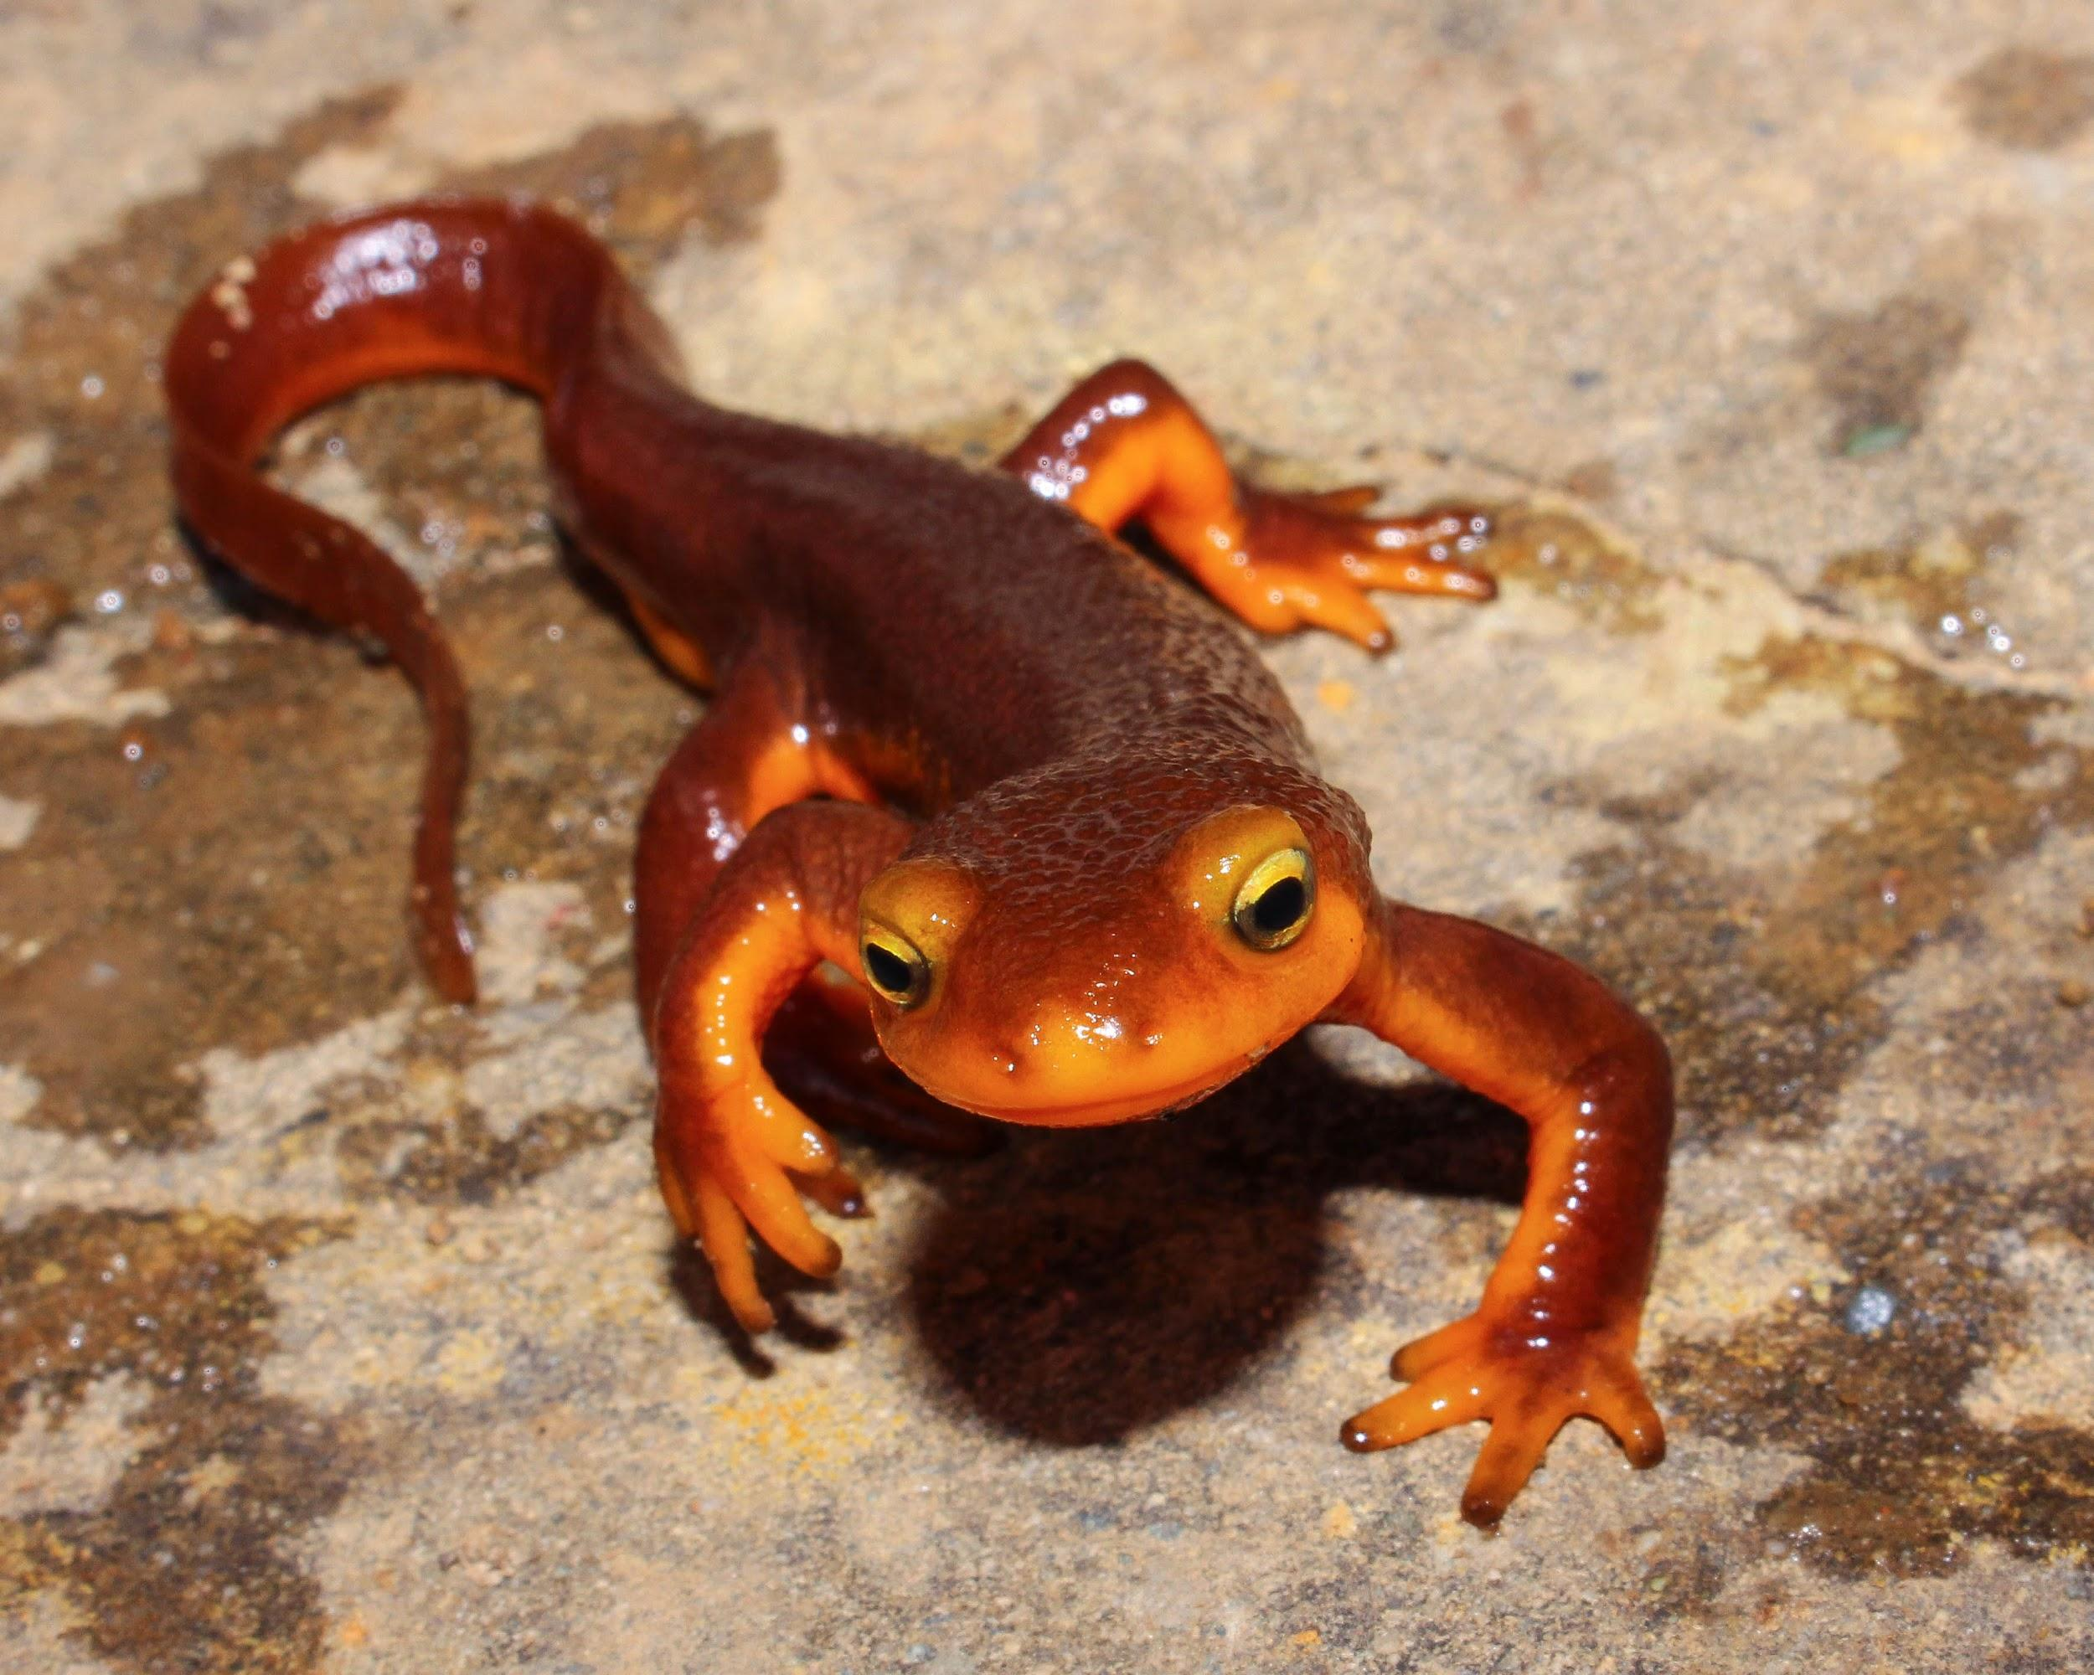
Amphibia
Can live on land but must return to water for reproduction.
Lay Eggs/External Fertilization
Slimy Skin, Scale-less
Gills as juveniles and lungs in adult mature forms.
Frogs, Toads, Salmanders
Notes:
Y

Slide 7
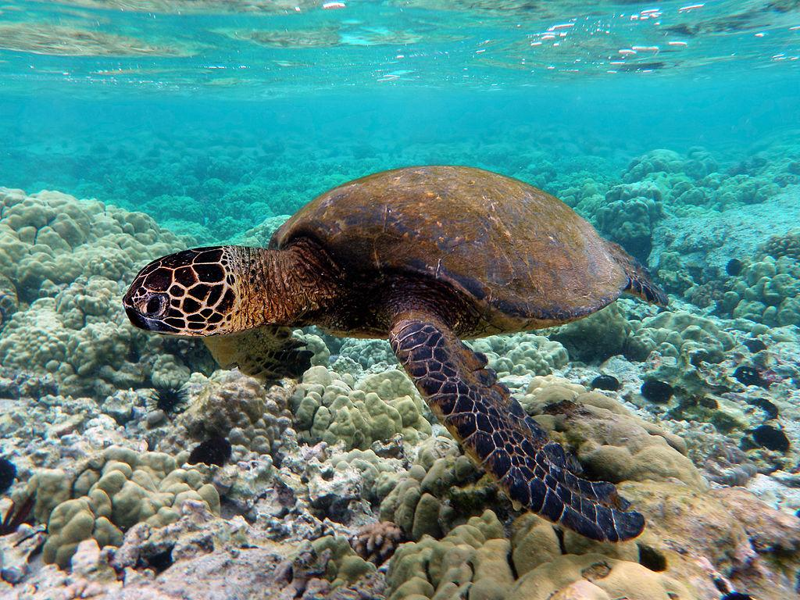
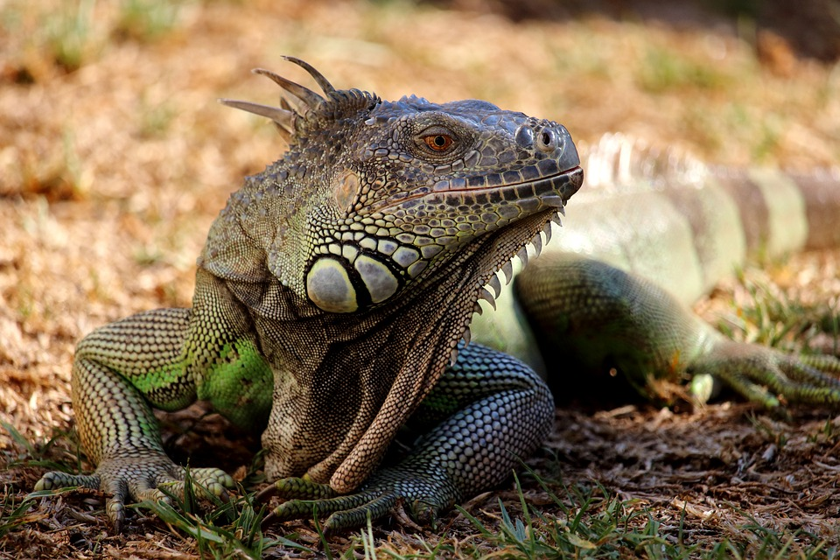
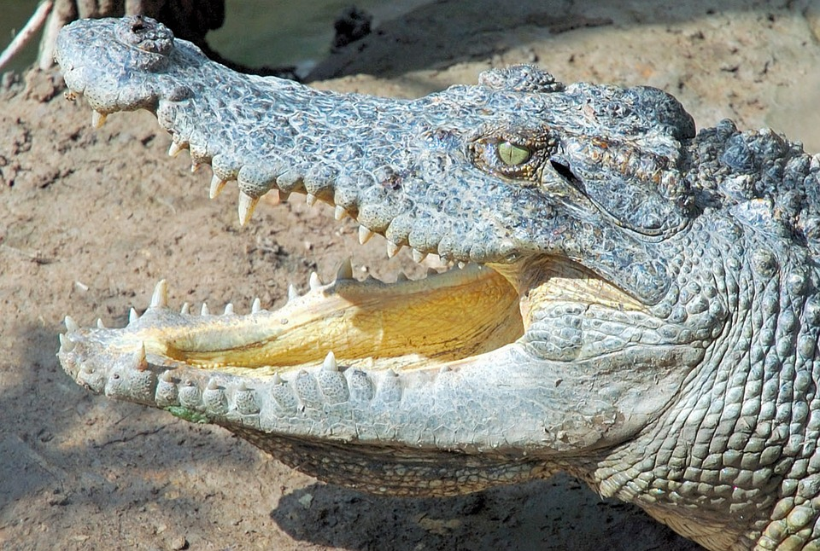
Reptilia
Dry, Scaly Skin
Ectothermic
2 Pairs of Legs
Lungs
Lay Eggs on Land
Internal Fertilization
Turtles
Crocodile
Alligator
Lizard
Snake
Notes:
I

Slide 8
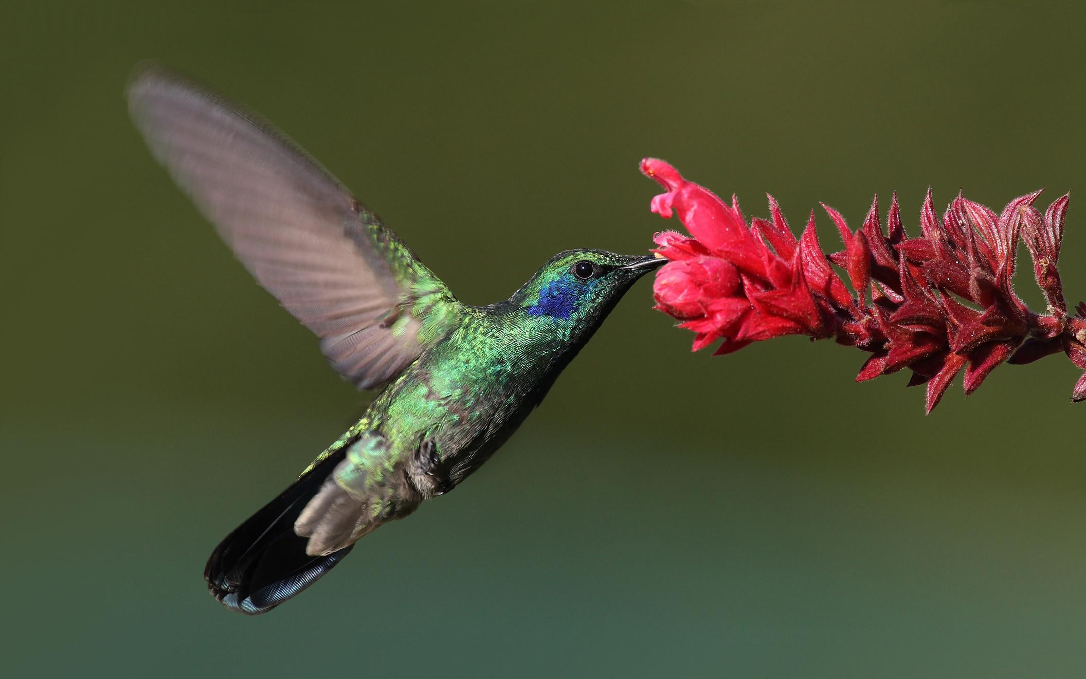
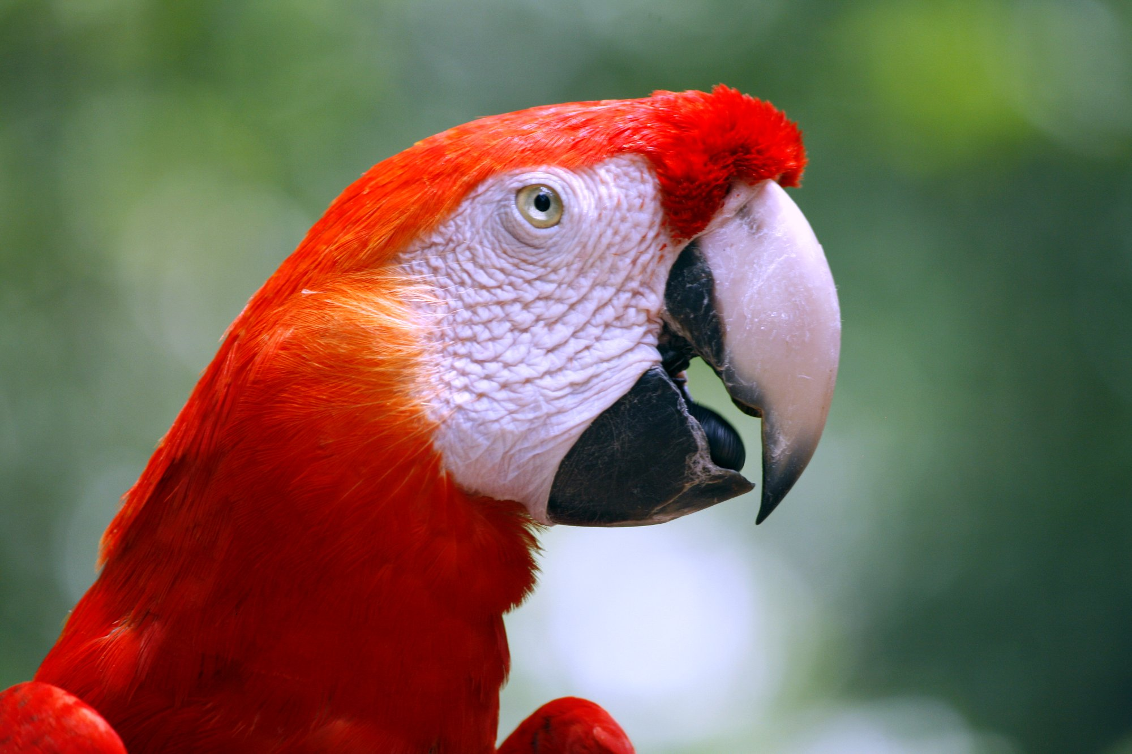
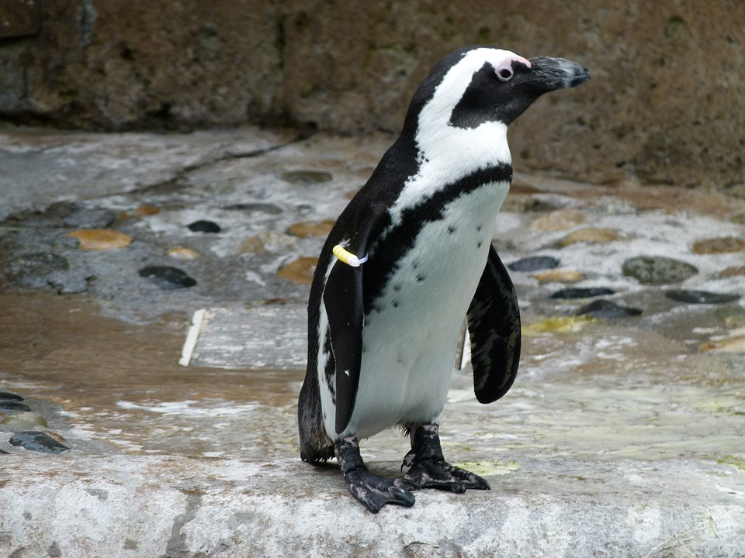
Aves
Penguin
Macaw
Turkey
Feathers (Modified Scales)
Scales on Legs
Endothermic (Homeostasis)
Internal Fertilization
Hollow Bones
Notes:
S

Slide 9
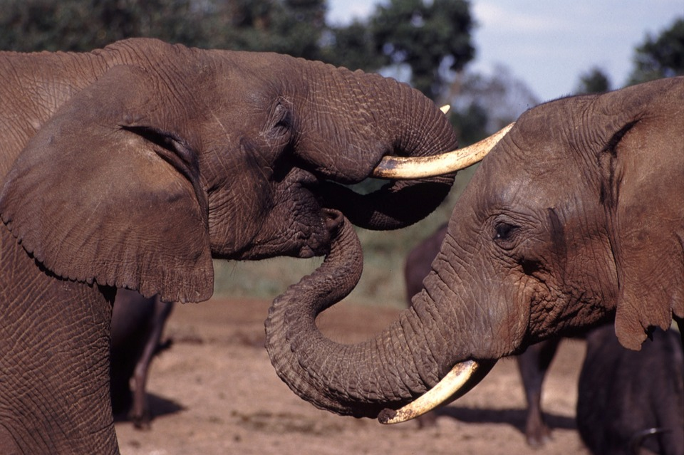
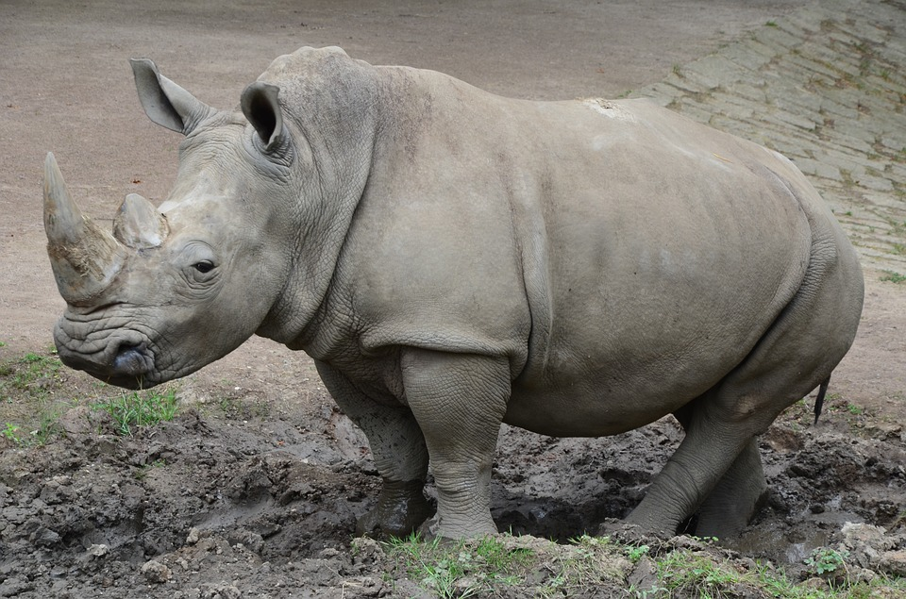
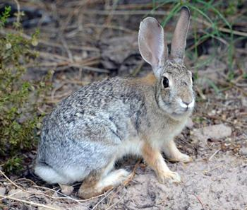
Mammalia
Elephants
Rhinoceros
Rabbits
Hair/Fur
Endothermic
Lungs
Internal Fertilization
Mammary Glands
Notes:
O

Slide 10
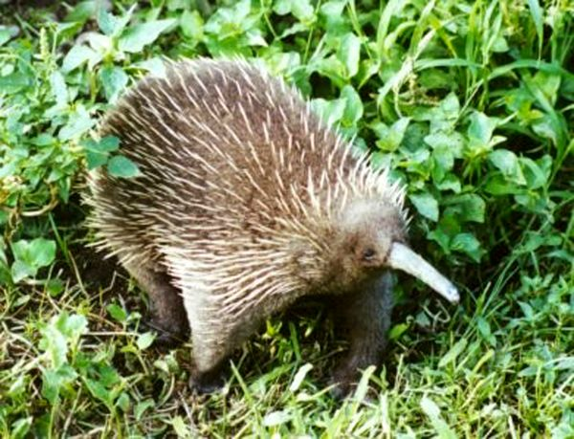
Monotremes
Subclass of Mammals
Mammals that Lay Eggs
Highly Modified Snout or Beak
Platypus
Notes:
E

Slide 11
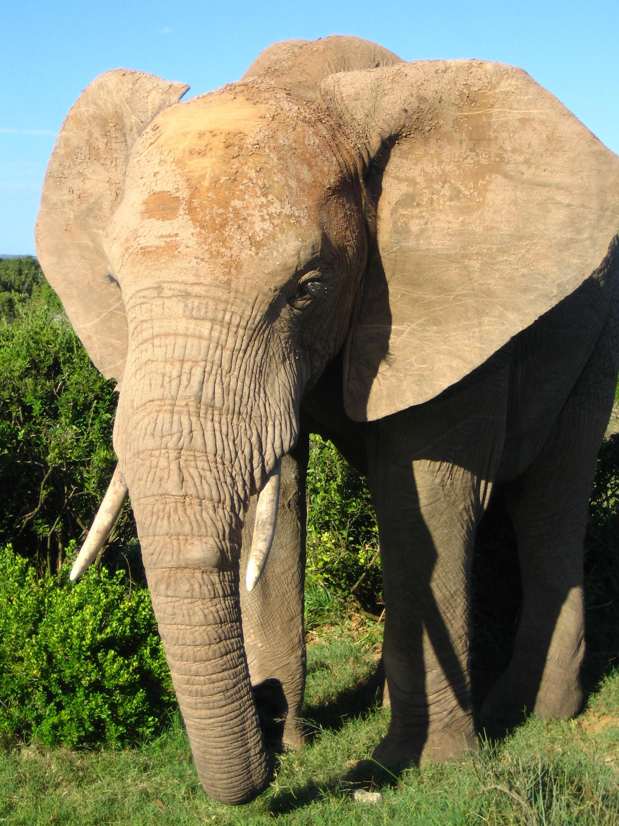
Placental
Subclass of Mammals
Mammals that bear live young.
Nourished before birth by the mother.
Elephant
Notes:
J

Slide 12
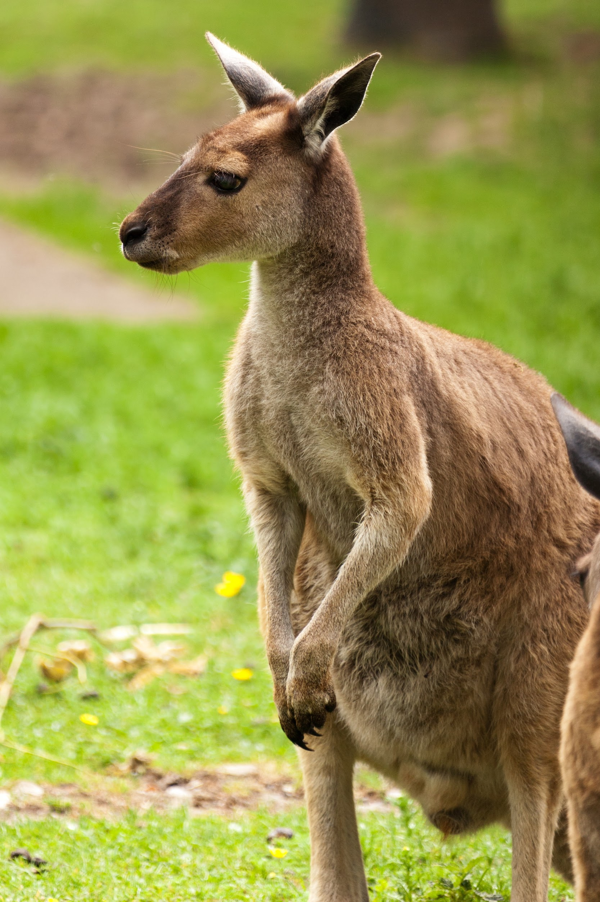
Marsupials
Subclass of Mammals
Mammals that give live birth and continue early development within a pouch
Kangaroo
Notes:
U

